Slide 1


Goldwyn School
Aspire | Empower | Achieve
Notes:
Kerry welcome

Slide 2
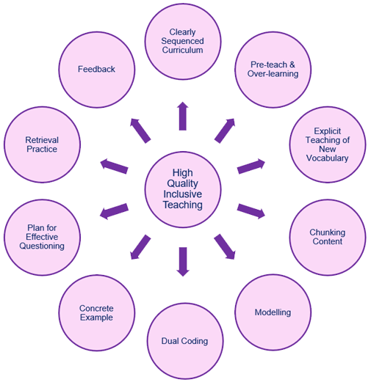


High Quality Inclusive Teaching
Informs the start of the lesson – confirms correct understanding and addresses misconceptions.
Plan to pre-teach new concepts and opportunities to regularly revisit.
Low stakes testing.
Mini quiz.
Multiple choice.
Ensure all new subject specific words are taught and embedded. Use e.g., Frayer Model or word web.
What? Where? When? Why? How?
Think, pair, share.
Mini White Boards
Teach new concepts in small manageable chunks.
Provide key examples to help reinforce understanding.
I do, We do, You do.
Create worked examples – use a visualizer or board.
Use words and images to prevent cognitive overload: graph, diagram, visual.
Adapted from Inclusion: A Principled Guide for School Leaders:
Nicola Crossley and Des Hewitt 2021
Notes:
Darren

Slide 3
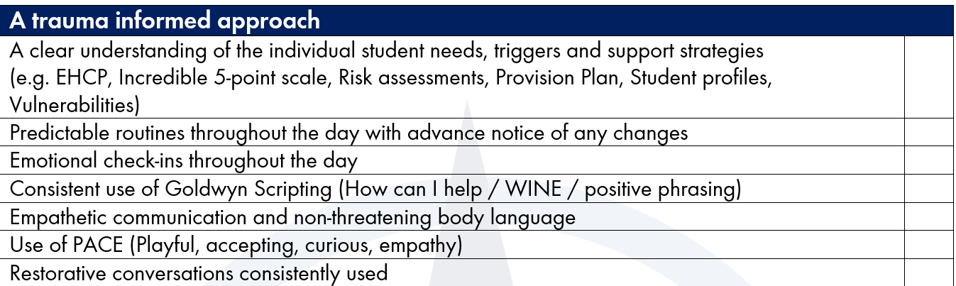
A trauma informed approach
Goldwyn School
Aspire | Empower | Achieve
Notes:
Rob - Building on the TIS UK and CPI training
In the classrooms …
First and foremost – understanding of the individual student needs
Keeping things predictable – advance notice and reminders of any changes
Goldwyn scripting – a consistent language – POSITIVELY PHRASED (wonder/notice/imagine/empathy)
PACE
Connection before correction
Being curious – what is their behaviour really communicating
Restorative conversations consistently used

Slide 4
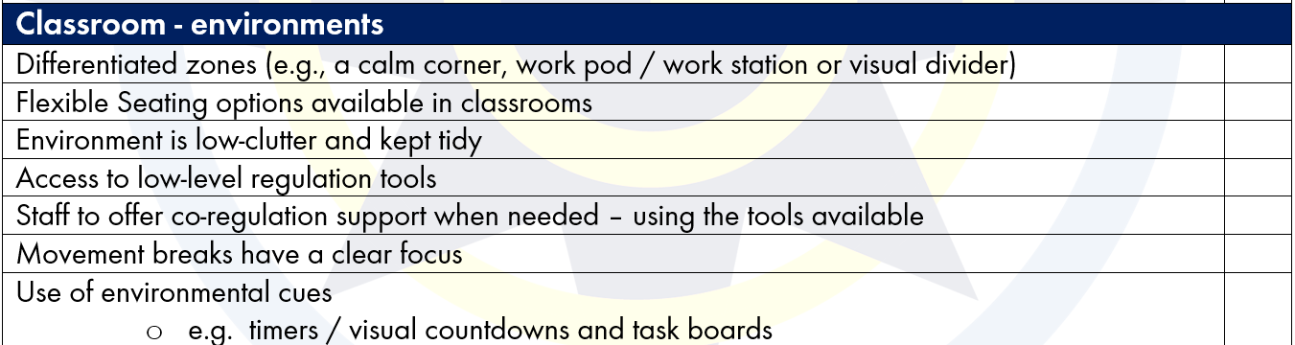
Classrooms
Goldwyn School
Aspire | Empower | Achieve
Environments
Notes:
Sarah
Visuals of flex seating, regulation toolkits
Movement breaks in class first then offer out – and to a space
e.g. timers / visual countdowns and routine boards / task boards to reduced cognitive load , support transitions and engagement in short learning tasks.

Slide 5
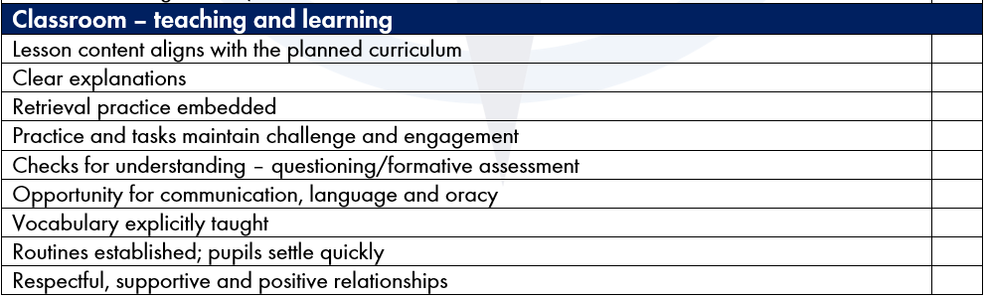
Classrooms
Goldwyn School
Aspire | Empower | Achieve
T&L
Notes:
Darren

Slide 6
Goldwyn School
Aspire | Empower | Achieve

