Slide 1


Notes:
Entrance to 'Ordinary' on loud for all in the hall
Welcome everyone
Good rest and replenish time
New starters (give us a wave ) – welcome – stand up welcome enjoy your day and term getting to know everyone.
Thank you to (stand up 1 by 1) Chris and Mark at GF sites work/ Mark Sibley- singlehandedly taking down the hedgerow co-ordinating exam results and works over the summer /Dawn overseeing the TUPE process for STLS/ James Tina Tammy Alison- finance start of term recruitment all SLT Exams officers – Jess
Flick to agenda for the day
Entrance song- Ordinary- because what I want from the curriculum and the experience we give our students is FAR from the ordinary- I want it to be extraordinary!!!

Slide 2

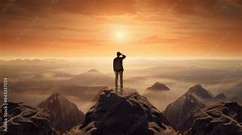
ASPIRE
Notes:
Entrance to 'Ordinary' on loud for all in the hall
Welcome everyone
Good rest and replenish time
New starters (give us a wave ) – welcome – stand up welcome enjoy your day and term getting to know everyone.
Thank you to (stand up 1 by 1) Chris and Mark at GF sites work/ Mark Sibley- singlehandedly taking down the hedgerow co-ordinating exam results and works over the summer /Dawn overseeing the TUPE process for STLS/ James Tina Tammy Alison- finance start of term recruitment all SLT Exams officers – Jess
Flick to agenda for the day
Entrance song- Ordinary- because what I want from the curriculum and the experience we give our students is FAR from the ordinary- I want it to be extraordinary!!!

Slide 3

EMPOWER
Notes:
Entrance to 'Ordinary' on loud for all in the hall
Welcome everyone
Good rest and replenish time
New starters (give us a wave ) – welcome – stand up welcome enjoy your day and term getting to know everyone.
Thank you to (stand up 1 by 1) Chris and Mark at GF sites work/ Mark Sibley- singlehandedly taking down the hedgerow co-ordinating exam results and works over the summer /Dawn overseeing the TUPE process for STLS/ James Tina Tammy Alison- finance start of term recruitment all SLT Exams officers – Jess
Flick to agenda for the day
Entrance song- Ordinary- because what I want from the curriculum and the experience we give our students is FAR from the ordinary- I want it to be extraordinary!!!

Slide 4


ACHIEVE
Notes:
Entrance to 'Ordinary' on loud for all in the hall
Welcome everyone
Good rest and replenish time
New starters (give us a wave ) – welcome – stand up welcome enjoy your day and term getting to know everyone.
Thank you to (stand up 1 by 1) Chris and Mark at GF sites work/ Mark Sibley- singlehandedly taking down the hedgerow co-ordinating exam results and works over the summer /Dawn overseeing the TUPE process for STLS/ James Tina Tammy Alison- finance start of term recruitment all SLT Exams officers – Jess
Flick to agenda for the day
Entrance song- Ordinary- because what I want from the curriculum and the experience we give our students is FAR from the ordinary- I want it to be extraordinary!!!

Slide 5

The SEMH Contiuumn
ASD
Sensory Processing disorder
ODD
Trauma
Anxiety
Personality disorder
OCD
Attachment Disorder
ADHD
PTSD
School anxiety avoidance
PDA
Notes:
Reasons why a child may have SEMH needs can include:
Attachment difficulties
Experience of trauma
Mental illness
A lack of opportunity to develop certain skills
A neurodevelopmental condition that may lead to difficulties communicating, understanding, regulating emotions, tolerating environments, concentrating or forming and maintaining relationships.
And many more reasons.
Students with SEMH needs bear the greatest disadvantage of all – one for which a cash premium itself will not resolve. If not addressed they will carry this with them throughout life despite economic prosperity or social mobility that often is deemed to resolve other “disadvantages”.
Furthermore social, emotional and mental health (SEMH) can hinder a child’s ability to access education leading to their opportunities being significantly reduced.
Introvert v Extrovert presentation- and needs that have a direct impact upon each other.

Slide 6
'There is no significant Learning without a significant Relationship'
Goldwyn Ashford
80 students
10-15 vulnerability factors
Goldwyn Folkestone
65 students
Children in care
KS3 Nurture
1 hr lessons – pre teaching and language
Goldwyn Time
45 minutes in length
Goldwyn time
Goldwyn Plus
20-25 vulnerability factors
Goldwyn Time
Engagement curriculum
Home support
Personalised multiagency programmes
Sixth Form Pure Goldwyn East Kent Colleges
Notes:
Entrance to 'Ordinary' on loud for all in the hall
Welcome everyone
Good rest and replenish time
New starters (give us a wave ) – welcome – stand up welcome enjoy your day and term getting to know everyone.
Thank you to (stand up 1 by 1) Chris and Mark at GF sites work/ Mark Sibley- singlehandedly taking down the hedgerow co-ordinating exam results and works over the summer /Dawn overseeing the TUPE process for STLS/ James Tina Tammy Alison- finance start of term recruitment all SLT Exams officers – Jess
Flick to agenda for the day
Entrance song- Ordinary- because what I want from the curriculum and the experience we give our students is FAR from the ordinary- I want it to be extraordinary!!!

Slide 7

Goldwyn School
‘The Whole Child Curriculum’
Notes:
At Goldwyn we deliver a 'whole child' and balanced curriculum.
our vision is by focussing equally on the social emotional creative side of our curriculum balanced with our qualifications we enable our students to be the best that they can be...

Slide 8





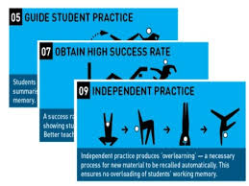

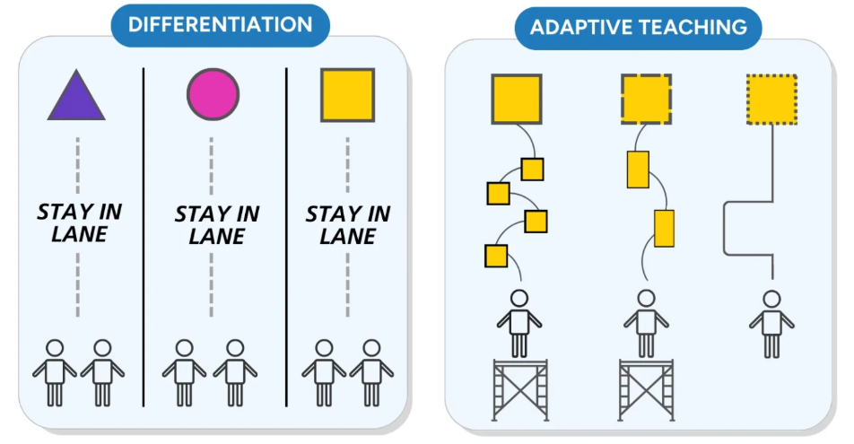



Balanced? A Whole Child Curriculum
Self esteem
Subject specialist knowledge
EHCP outcomes
Experiences
apprentices
Goldwyn Time
Team work
Baseline assessments
employability
Safe
College
Wellbeing
Heathy
Specialist vocabulary
Valued
Work experience
Friends
Learning acquisition
Extra curricular
Engagement
Attendance
Qualifications
Notes:
In our classrooms we are making adaptations and considering the gains we can have across all aprcts, enagement attendnace wellbeing soicial connect breaking barriers to learning through pre teaching
From our journeys into school that is where our 'Whole child curriculum' begins
Feeling wanted/ belonging, selfesttem coping mechanisims connecting with peers on the way to school having a conversation with the driver
In the offices social interactions routines safety
We do ALL of these things to build on our aspirations- we need to lift the celing- like Hywell said- many many specialist settings are really good at the love and care part- but to be 'extrodinary' we need to balance the scales and
ASPIRE EMPOWER AND lead our students to ACHIEVEMENT

Slide 9
Goldwyn School
‘The Whole Child Curriculum’
Notes:
At Goldwyn we deliver a 'whole child' and balanced curriculum.
our vision is by focussing equally on the social emotional creative side of our curriculum balanced with our qualifications we enable our students to be the best that they can be...

Slide 10
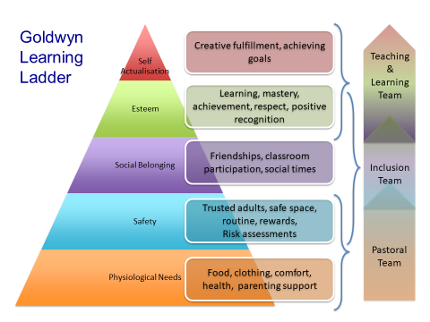
Maslow
A curriculum design

Slide 11

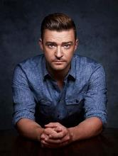

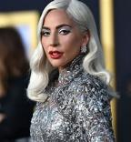
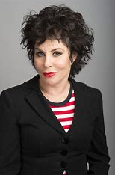

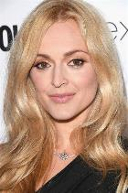
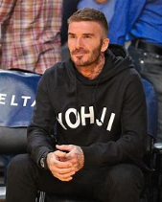
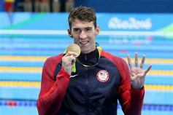
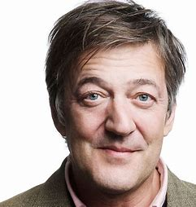
See Strengths not weakness…
Notes:
All of these well known figures have an SEMH diagnosis- some indeed struggled significantly at school?
Sometimes the system has measured the wrong things and deemed people like these as a failure- our stenth is we DO NOT- we see the Whole child and their strengths- we aspire for them when they feel they cannot aspire for themselves- and we empower them to become their best- I would not want to be a part of any organization that didn’t nurture and empower its community as you do!
Diversity is richness in what we offer- if we offered the same curriculum in the same way quite frankly our jobs would be boring! Lets be honest the system over years and years has disadvantaged rather than raised these type of students- It is our job to be a champion and do what is right…

Slide 12
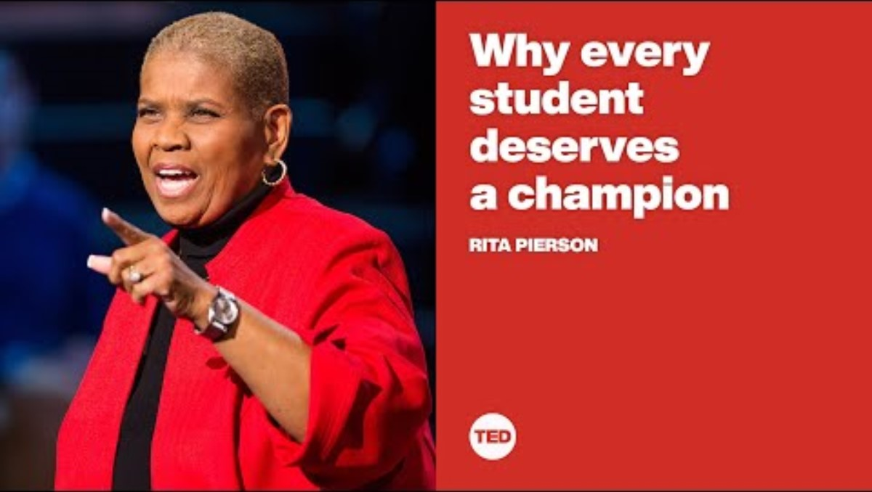
Every Child deserves a Champion

Slide 13
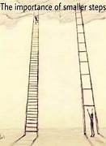

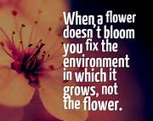
"Our system historically hasn’t looked at the whole child....
Or indeed measured the people we turn out into the world!"

Slide 14
Imagine you as a trainee teacher- what did you dream of?
What was your goal?
What filled your cup?
Notes:
At Goldwyn we deliver a 'whole child' and balanced curriculum.
our vision is by focussing equally on the social emotional creative side of our curriculum balanced with our qualifications we enable our students to be the best that they can be...

Slide 15
Passionate committed teachers
Relational practice
A 'whole child education'
THE BIGGEST IMPACT
Notes:
At Goldwyn we deliver a 'whole child' and balanced curriculum.
our vision is by focussing equally on the social emotional creative side of our curriculum balanced with our qualifications we enable our students to be the best that they can be...

Slide 16
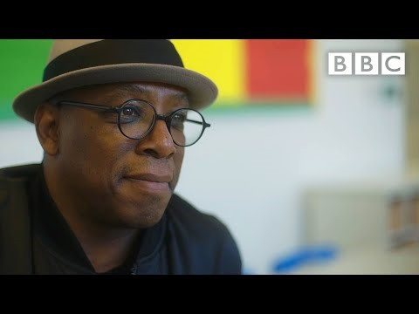
In the business of changing lives…
Notes:
Will you be the difference? Don’t underestimate the impact all of us in here can have- especially if we work as a team!

